Slide 1
Macrosoft KHIRKI 9
Design documentation
By Barkhi Ul Haque Khan 29261
Instructor Jawwad Ahmed
IBA Karachi

Slide 2


MACROSOFT KHIRKI: Opening the pardah to the 8-Bit World!

Slide 3

What is a CPU
Unlocking the Wonders of 8-Bit Computing with Macrosoft Khirki!
C P U, the central processing unit
It does the all the required processing
It takes in data, gets instructions and then executes the said instructions in a specific sequence
┻┳| ______________________
┳┻| _ ( ill show you how in a while)
┻┳| •.•) ﾚ¯¯¯¯¯¯¯¯¯¯¯¯¯¯¯¯¯¯¯¯¯¯¯¯¯¯¯¯¯¯¯¯¯¯¯¯¯¯¯¯¯¯¯¯¯
┳┻|⊂ﾉ
┻┳|
=
?

Slide 4
But first: How it do?
Computers are stupid but good and fast workers.
They do exactly as told (EXACTLY!), we need them to apply some logic on their own y’know?
So we introduce ‘Logic gates’ , the CPU's braincells
The more the gates the better it thinks
They aren’t actual gates with door knobs but components that control whether a bit can flow through or not

Slide 5
BITS
Bits of what ?
NUMBERS DUMMY!
1s and 0s, we’ve all seen The Matrix, a stream of random 101010001001 but what if I told you they aren’t random?
It is a language designed for computers, its quite literally a yes no statement, yes? Then the value is 1, no? then the value is 0.
Don’t understand? Well don’t worry, its not for us to understand anyway(not always at least), but fear not because you will in un momento.

Slide 6
Still bits: but MORE
A 1 or 0 is not enough, we need more numbers.
This is where we put the numbers together and get unique combinations that we can give values to like a number system viola we have the binary number system(the normal numbers we use is called the decimal .
For example: here the combo 00 = 0 and 01 =1 and 10 =2 and 11=3
binary | decimal
00 | 0
01 | 1
10 | 2
11 | 3
Now we get the values by using this handy dandy system, this system is based on 2-the power of 2.
The first digit (or the 0th to be exact) is interestingly on the right

Slide 7
Still??
yes
This is 173 btw
Exponent
Value
binary
2⁷ | 2⁶ | 2⁵ | 2⁴ | 2³ | 2² | 2¹ | 2⁰
128 | 64 | 32 | 16 | 8 | 4 | 2 | 1
0 | 0 | 1 | 1 | 0 | 0 | 1 | 0
Now, we have the number 00110010, read right to left.
We add the value for each position the ‘bit’ is ‘ON’ aka 1 and get its sum
0+0+32+16+0+0+2+0=50, this 50 is the fifty we all know and love, the purple note 50.
Understood? Yes? Great!! Now clap for yourselves my cheeky cheeky boy just translated a ‘BYTE’ WOOOoooh…. you don’t know what that is?
Well~ a byte is just 8 bits holding hands and having one total value like right now.

Slide 8

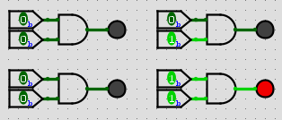
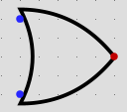
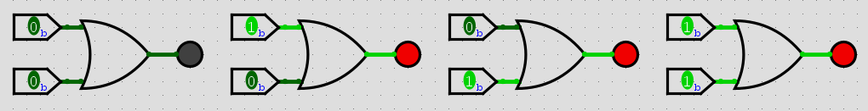


Logic gates
This letter D is an AND gate, as the name implies it only passes a value if all bits are ‘HIGH’ aka ‘on’(this AND that must be 1)
This arrow head is an OR gate, as the name implies it passes a value if at least one bit is ‘HIGH’(this OR that must be 1)
This shuttlecock is a NOT gate also known as an inverter, as the name implies it inverts the bit’s state/value(this is NOT that)

Slide 9




Aur bhi?
This arrow head with a tail is a XOR (exclusive OR) gate, it passes a value if one bit is ‘HIGH’(this AND that must be 1)
This AND with a pimple is a NAND (NOT AND) gate, as the name implies this is an inversion of an AND.

Slide 10
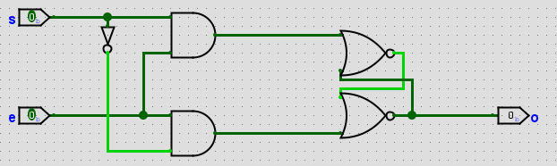
How do it remember
Memory, duh.
What we use as a memory is what is called a flipflop or a latch, it stores a bit of information till it is told otherwise.
This is a flipflop, it stores the bit state of S in O only if E is on

Slide 11
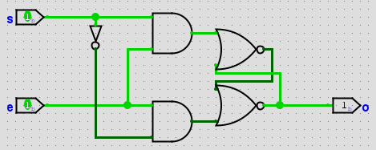
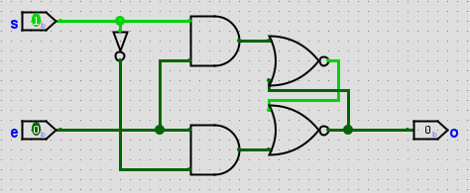
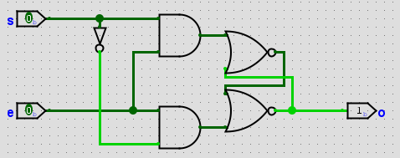




Amnesia?
What? Are you surprised? Well don’t be, a lot more is to come you’ll run out of energy.
Of course it remembered, that's what
I made it to do

Slide 12
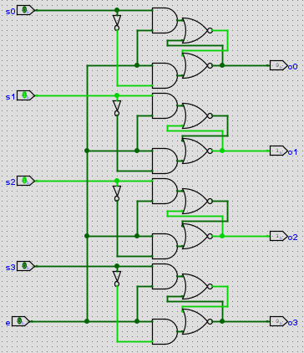
Big brain?
This is an example to save only 4 bits of data, but it scales up to any bit size.
But what if we need to save some data but we don’t want it to be outputted constantly, you need a gate, an enable if you allow, you don’t? well I dont care. We’re doing this.

Slide 13
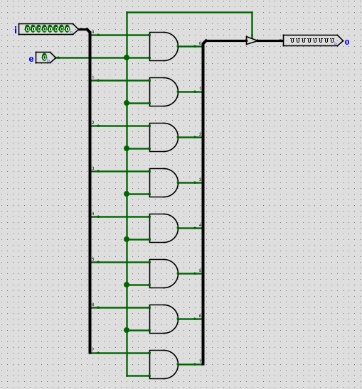
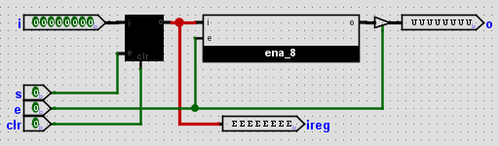




Ab deckho!
This is an enable circuit, the byte at I doesn’t output until and unless E is ON.
This is a REGISTER this little thing stores 8-Bit values and only outputs it when instructed

Slide 14
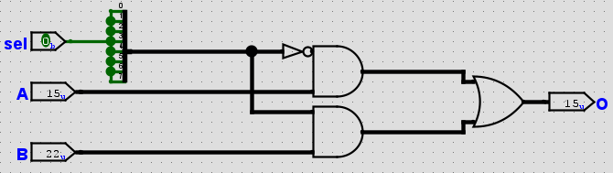
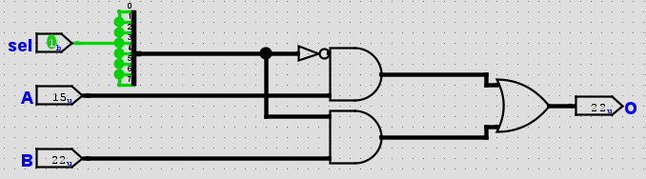
Slytherin? Griffindor!
This right here is called a MUX or a multiplexer, it selects what bit or byte to output.
When the sel bit is ‘0’ A is outputted.
When the sel bit is ‘1’ B is outputted.

Slide 15
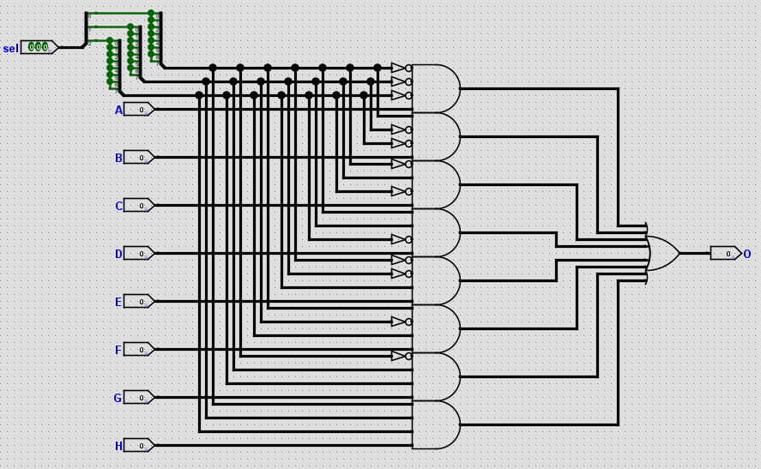
8 8 8 8 what is with all the 8’s??
Muahaha have more!
This boy is an 8 by 1 mux
This has 8 input values, but It can choose between them.

Slide 16
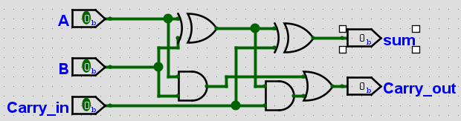
ADDITION!!
This child is called a full adder, he adds the two input bits while having a carry in and a carry out.
Huh? I didn’t tell you what that is? Sigh okay fine let's rewind a little, come on along.

Slide 17
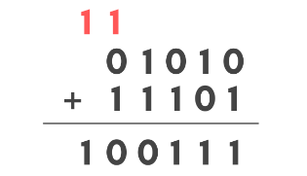


Marty get back in the car
So you know to carry a 1 when adding two numbers in math class? Good, same goes on here even if its binary. Reds the carry btw.
The 1 carries oven and adds, this is why we have a carry in and carry out in the full adder, but that’s only 1 bit, we need more.

Slide 18
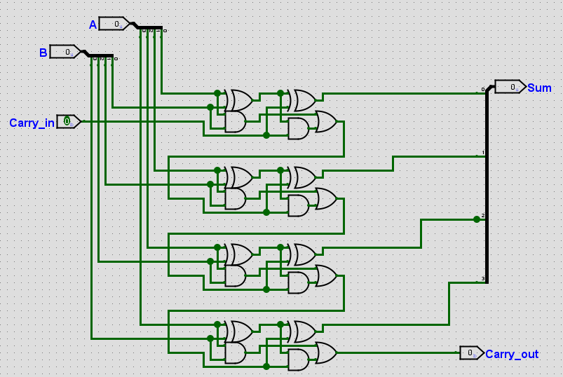
Yum it’s a sum
This is a 4 bit adder, see how there are 4 full adders? this way we can scale it up to how many we want, yes, even to 256 bits.

Slide 19
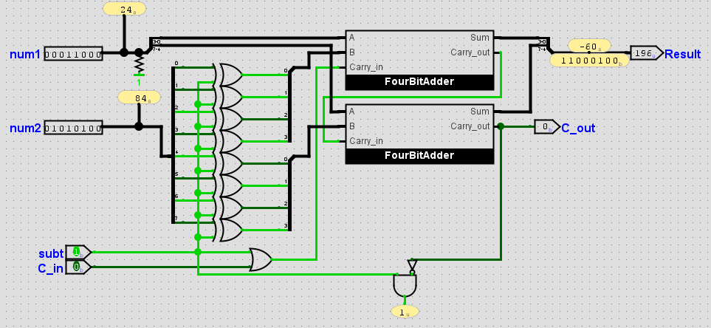
Oh wow! Would you look at then time?
It’s getting late, “It's Morphin' Time!”.
so, you recognize that this as an 8 bit adder, good. Ooh! you’re getting good, yes its as you see the adder is actually subtracting right now and gave a negative number!

Slide 20







You look nice!, you too
How we do that is with two’s complment, its justa way to write negative numbers in binary.
Its done by first inverting all the bits and then add one bit only to the first bit
1 | 0 | 0 | 1
0 | 1 | 1 | 0
0 | 1 | 1 | 1

Slide 21
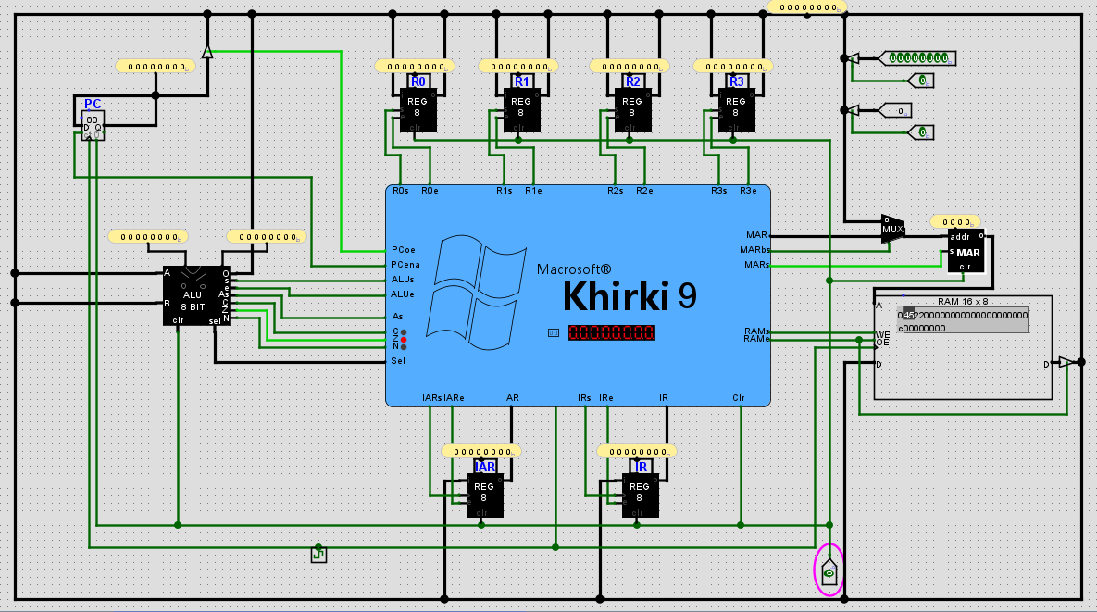
Copy much?
The basics now aside we can look at the architecture of the cpu.

Slide 22
Lisht
There only a few general components for the cpu
RAM
ALU
IAR
IR
General registers
PC
MAR
CU
BUS

Slide 23

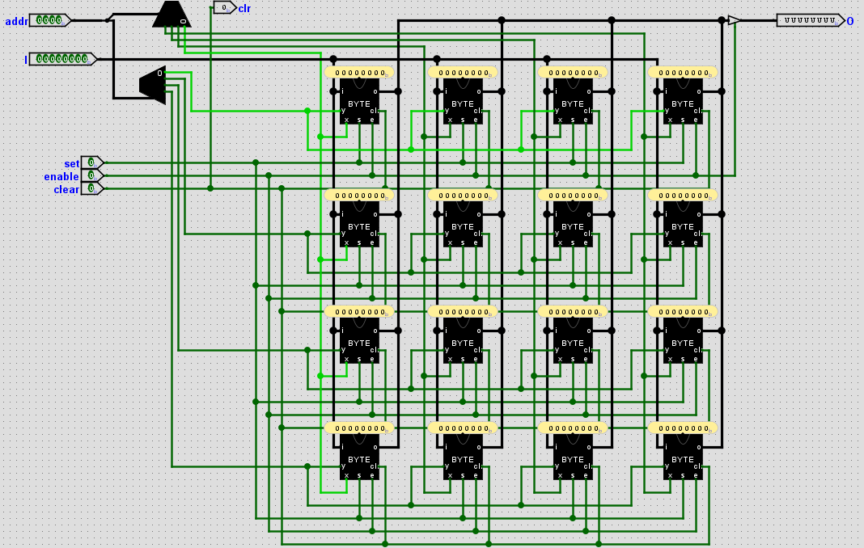
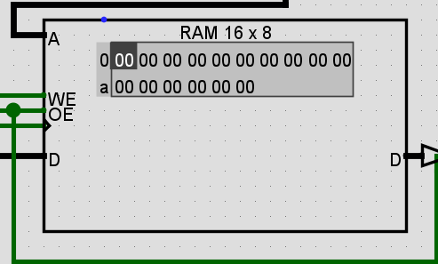
RAM
Ram is basically a grid of registers that you can select, this selection resemples a coordinate system.
There is a 4 bit address, whick equates to 16(2⁴) storage bytes
the values are stored as HEX

Slide 24
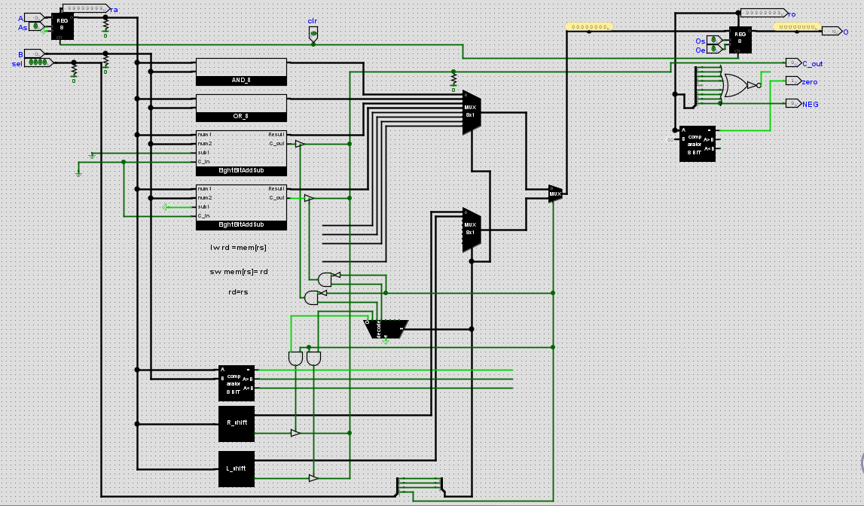
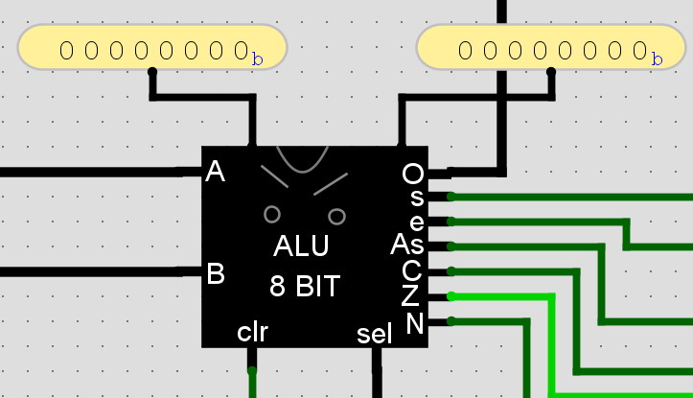
Mr. Potato
Mr. Potato here is the ALU - Arithmetic Logic Unit
He handles all the calculations, it’s told what to output using a mux and opcode. What’s opcode?, ill tell you in a while.

Slide 25
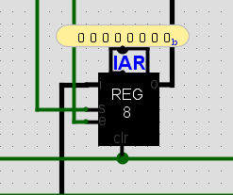
IAR
The IAR (Instruction Address Register) is a register with a specific purpose. It stores the value of the PC(program counter) and essentially acts as a storage for the address of said program in the ram
Although it is an 8 bit register it stores only 4bits of useful memory.

Slide 26
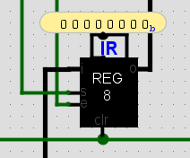
IR
The IR (Instruction Register) stores the value of the current instruction to run, this register is the primary memory for the CU so that it knows what sequence of instructions to execute.
All 8 bits are useful

Slide 27
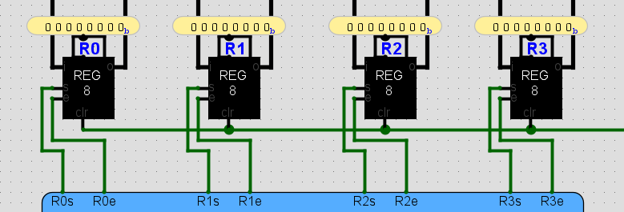
General registers
These registers are the CPU's internal memory, if it were a real cpu these would be its l1 cache.
The ALU gets its data from and to these 4 registers.
The ALU doesn’t have a direct connection to the ram
All MOV SW and LW operations happen on these

Slide 28
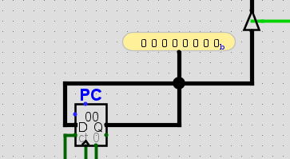
PC
The PC (Program Counter) is literally just a counter for how many micro programs have occurred
This counter is used to proceed to the next program by incrementing the address of data in the ram

Slide 29
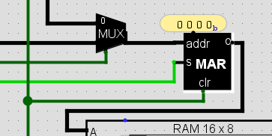
MAR
The MAR (Memory Address Register) is another specialty purpose register.
It holds the memory address of the data the ram is ret to work on,
This is different from the IAR as this is actively what controls the address of the data, whatever is in the MAR is the address of the data being accessed
The mux is used to select whether to take the address from then bus or from the CU

Slide 30
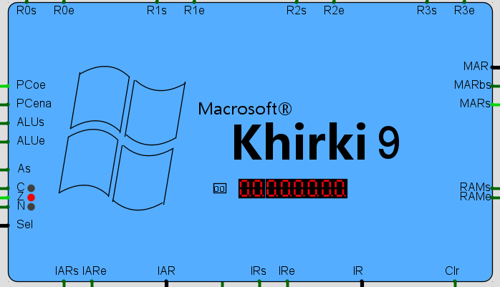
CU
The CU (Control Unit) is quite literally the brains of this operation (pun intended)
This handles all the conditions and Input outputs etc.
Like the name implies it controls everything, this is what makes a cpu automated
Everything is connected to this

Slide 31
Beep Beep W-11 incoming
A bus is just a common data line for all the components to communicate on.
While there can only be one byte of information on the bus at any instance, this can be worked around using the registers as temp memory.
All the black lines are a bus
Notice how both the inputs and outputs are both connected to it

Slide 32
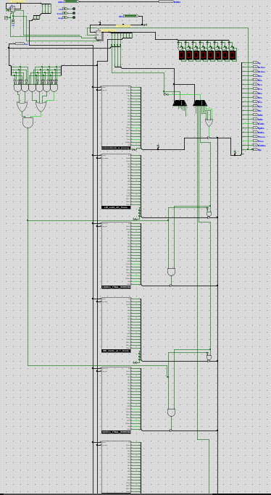
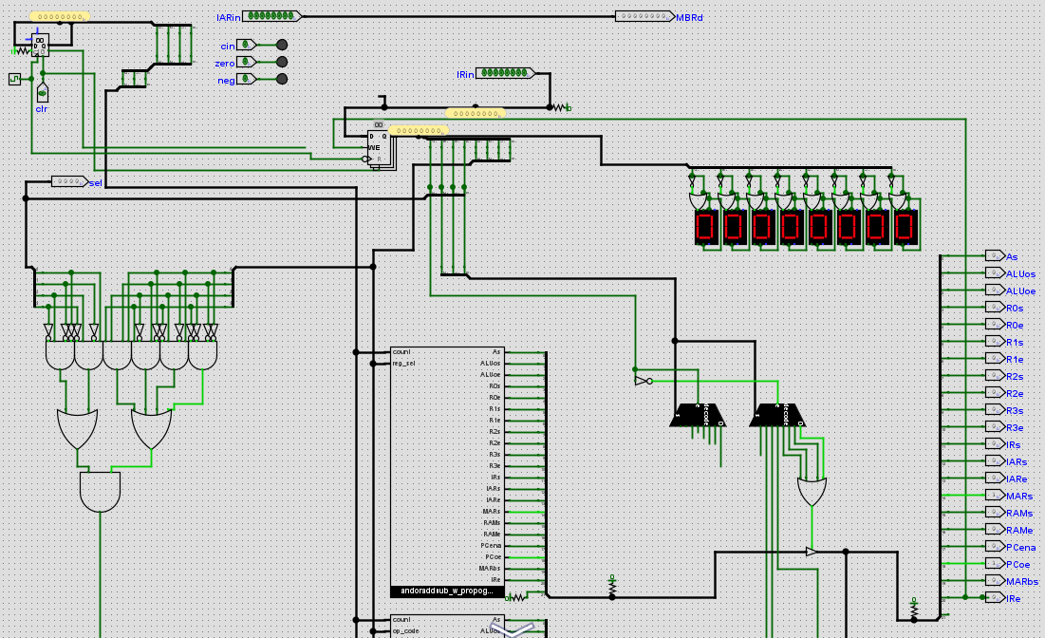
An apple a day keeps the doctor away
This is a CT scan of the brain,scary
Notice how there is another counter inside the cu, this counter controls what line of ‘code’ runs
The mux controls what instruction is being outputted like how it worked in ALU with the opcode

Slide 33
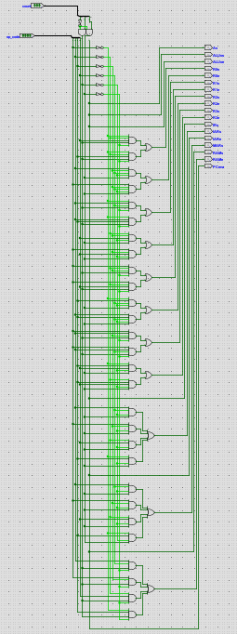
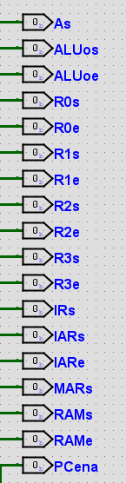
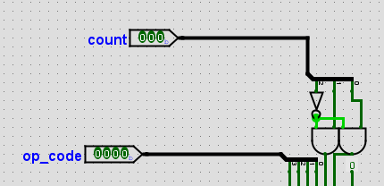
Jungle of wires
This is the logic for the LW (load word) instructions

Slide 34









Opcode this opcode that
REG A
00 | REG 0
01 | REG 1
10 | REG 2
11 | REG 3
OP CODE/OPPERATION
0000 | AND | 0
0001 | OR | 1
0010 | ADD | 2
0011 | SUB | 3
0100 | LW | 4
0101 | SW | 5
0110 | MOV | 6
0111 | NOP | 7
1000 | SHR | 8
1001 | SHL | 9
1010 | INC | A
REG B
00 | REG 0
01 | REG 1
10 | REG 2
11 | REG 3
0 | 1 | 1 | 0
0 | 1 | 1 | 1

Slide 35
AND(0000) OR(0001) ADD(0010) SUB(0011)
AND RA, RB OR RA, RB ADD RA, RB SUB RA, RB
For example ADD has the opcode 0010 and I select the registers 0111 making the opcode 00100111.
This translates to ADD R1, R3.
Meaning ADD the values in registers 1 and 3 and save in register 1
This applies for all and or add sub operations just the first 4 bits change accordingly
In hex 00100111 translates to 2 7 and this is what will be entered into the ram.

Slide 36
LOAD WORD (LW)(0100)
LW RA, RB
Meaning load value from memory location in RB at RA
For example LW has the opcode 0100 and I select the registers 1001 making the opcode 0100 1001
LW R2, R1
In hex it translates to 4 9
Load value from the memory location in R1 into R2

Slide 37
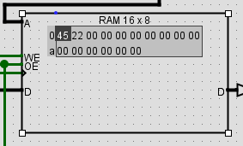


LWim
This is a special LW opcode in this the registers must be the same
Like
This is to load values in the registers themselves, then how else will we perform the other opcodes? they operate assuming there are already values In the registers.
LW RA
40, this loads the data from right ahead it in the ram to R0
4A, this loads the data from right ahead of the opcode in ram to R2
0000 | R0 | 0
0101 | R1 | 5
1010 | R2 | A
1111 | R3 | F

Slide 38
SAVE WORD (SW)(0101)
SW RA, RB
Meaning save value from RA to memory location in RB
For example, SW has the opcode 0101 and I select the registers 1001 making the opcode 0101 1001
SW R2, R1
In hex it translates to 5 9
Save value from R2 to memory location in R1

Slide 39
LWim
This is a special SW opcode in this the registers must be the same
Like
This is to save values from the registers themselves, this is the only way to store a value in the ram directly without needing an address as.
SW RA
5F, this saves the from R3 directly to the location right ahead it in the ram
50, this saves the from R0 data right ahead of the opcode in ram
0000 | R0 | 0
0101 | R1 | 5
1010 | R2 | A
1111 | R3 | F

Slide 40
MOV(0110) move
MOV RA, RB
This moves value from RB to RA without flushing RB’s value
0110 0110 this means move value from R2 to R1 while keeping R2
Hex= 6 6

Slide 41
NOP (0111)
NOP RA
Does nothing
HEX = 70

Slide 42
SHR(1000)
SHR RA
This shits the bits of the value in RA to the right by one position
For example SHR R2 means that If the value is 10001010 it gets outputted as 01000101 and the 0 removed is called a spill which is still outputted as cout
HEX = 8a

Slide 43
SHL(1001)
SHL RA
This shits the bits of the value in RA to the left by one position
For example SHL R2 means that If the value is 10001010 it gets outputted as 00010100 and the 1 removed is called a spill which is still outputted as cout
HEX = 9A

Slide 44
INC(1010)
INC RA
This just adds a 1 to the whole value
For example INC R3 means that If the value is 10001010 it gets outputted as 10001011
HEX = AF

